Slide 1
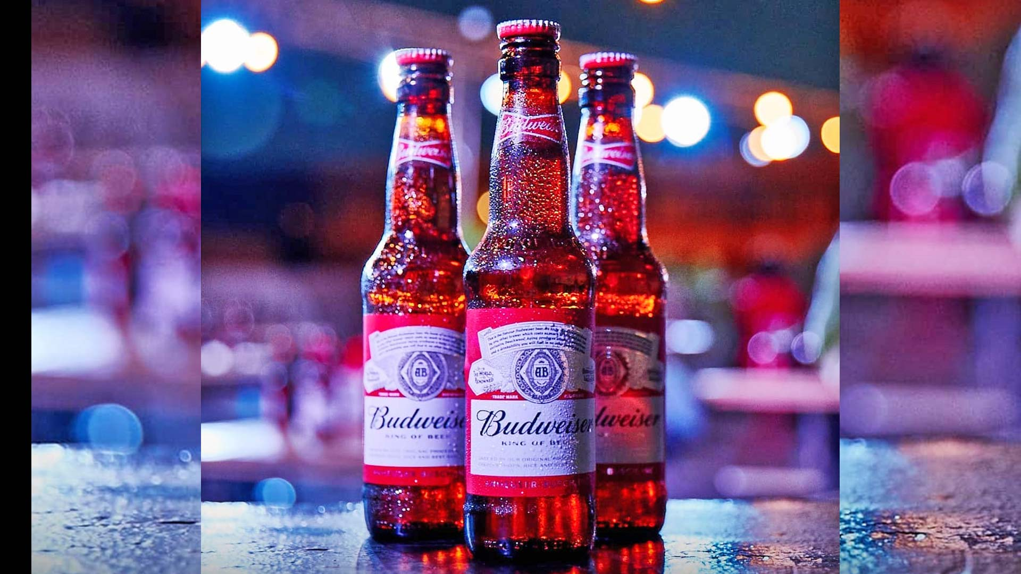
Budweiser Data Analysis

Slide 2
Carlos Brito - CEO Fernando Tennenbaum - CFO
Audience
Data Analysis Report Prepared
Zach Zaiken, Data Scientist @ SMU
Rinku Lichti, Data Scientist @ SMU
Feby Thomas, Data Scientist @ SMU
Documentation:
Link to Github: https://github.com/zz415/SMU_DS_6306_Case1
Link to Knit File: https://zz415.github.io/SMU_DS_6306_Case1/10.20.20-Budweiser_Data_Analysis_knit_file.html

Slide 3
Key Findings
Breweries by State
Impact of Missing Data
ABV & IBU by State
Distribution and Statistics of ABV
Relationship between ABV & IBU
IPA vs Ale
Opportunities for Market Expansion

Slide 4
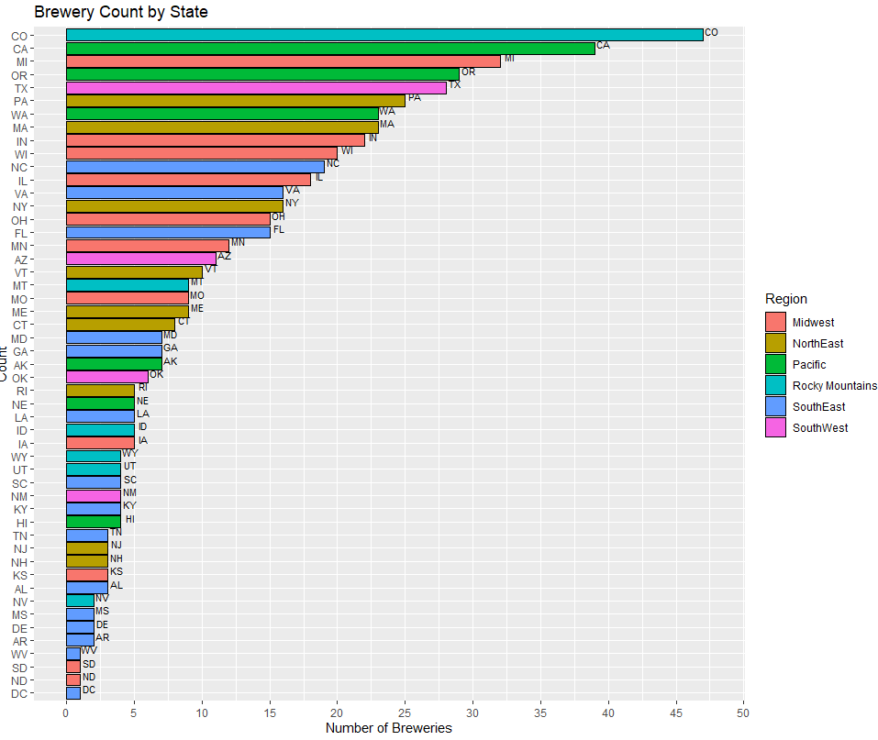
Breweries by States
Data Inferences
Large market presence in CO, CA ,MI ,OR, & TX
Majority of breweries is located in Midwest & Pacific regions
Small market presence in Southwest and Rocky Mountain Regions
May need to consider the cost of operating costs and supply chain fees in states with low brewery count. Money better spent in regions with established brewery presence

Slide 5
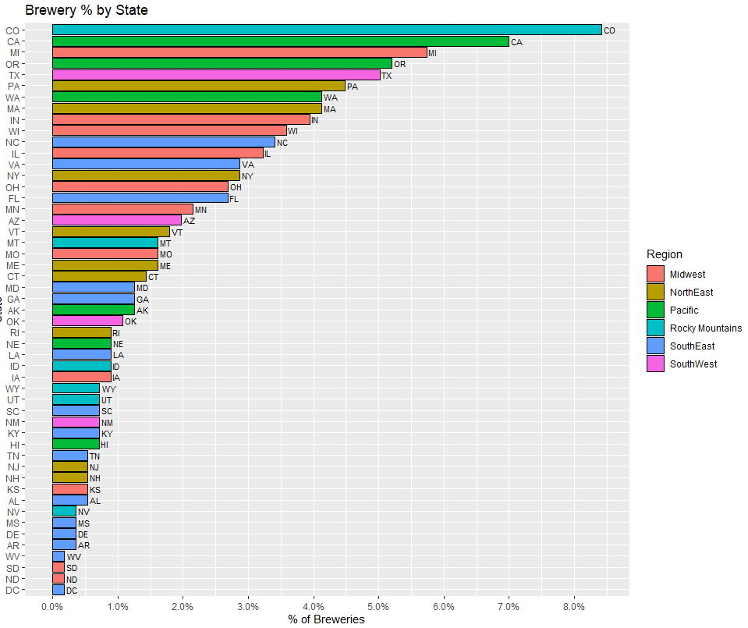
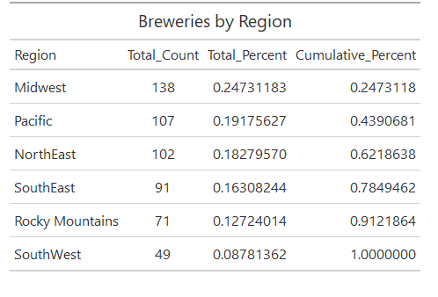
Breweries by State & Regions
Data Inferences
Large market presence in CO, CA ,MI ,OR, & TX
Majority of breweries is located in Midwest & Pacific regions
Small market presence in Southwest and Rocky Mountain Regions
May need to consider the cost of operating costs and supply chain fees in states with low brewery count. Money better spent in regions with established brewery presence

Slide 6
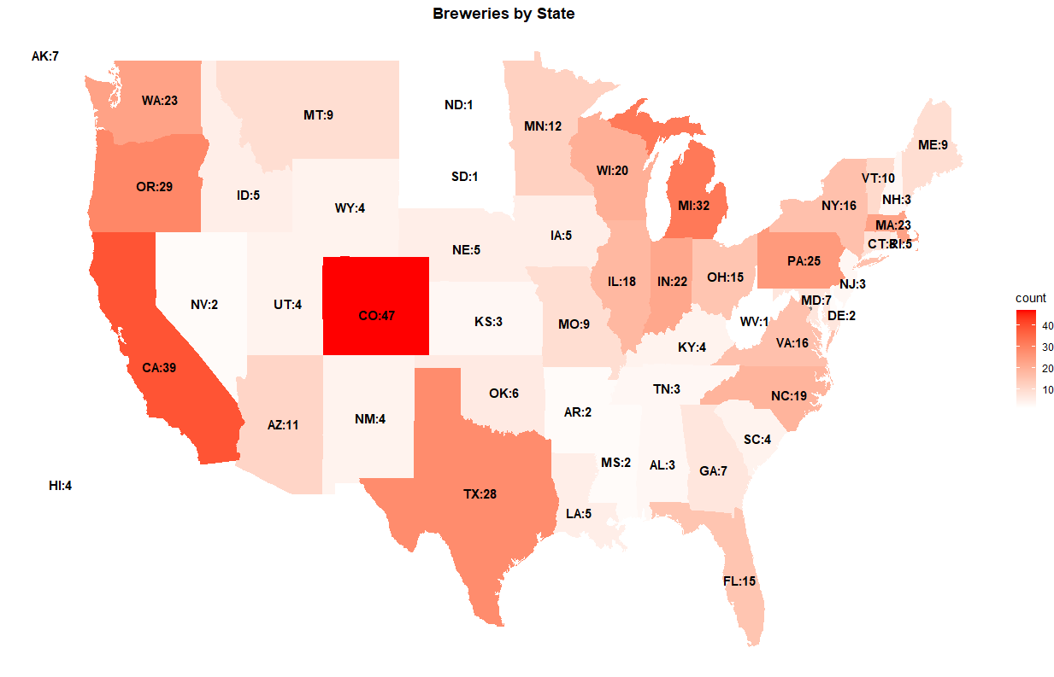
Heat Map of Breweries by State

Slide 7
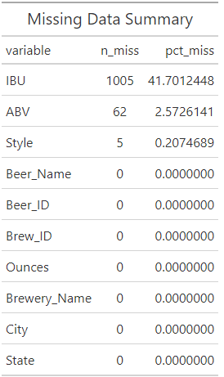
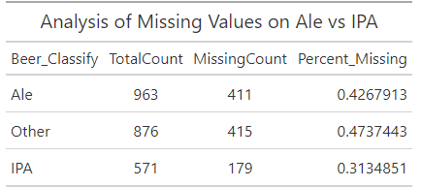
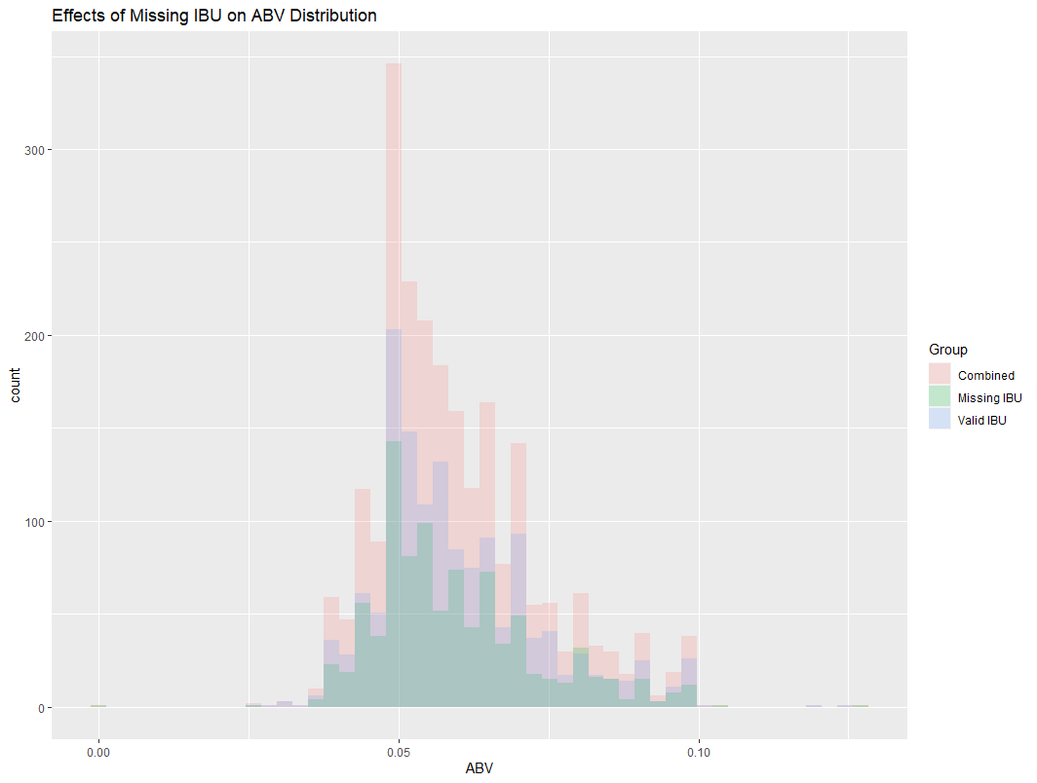
Missing Data : Analysis Summary
Data Inferences
Missing data for ABV and Style is negligible
Significant amount of IBU data missing (41.7%)
Distribution of ABV variable remains largely unchanged based on inclusion/exclusion of beer with missing IBU
Similar % missing for ALE/IPA based on exclusion of missing IBU data
Missing IBU data will be removed when looking at IBU vs ABV relationship and using IBU/ABV data to classify Ale vs IPA.

Slide 8
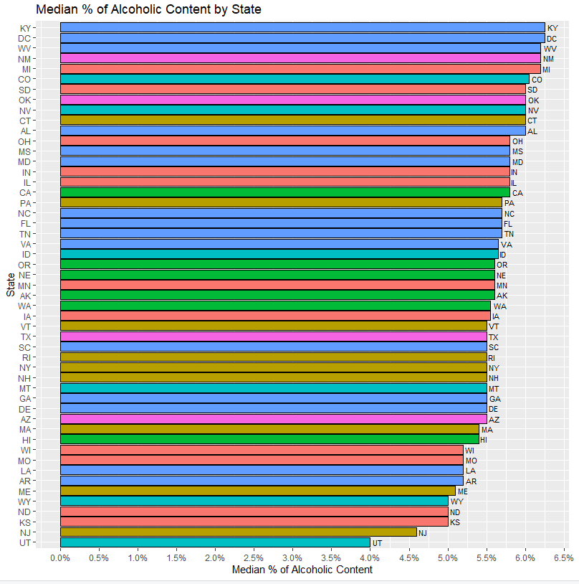
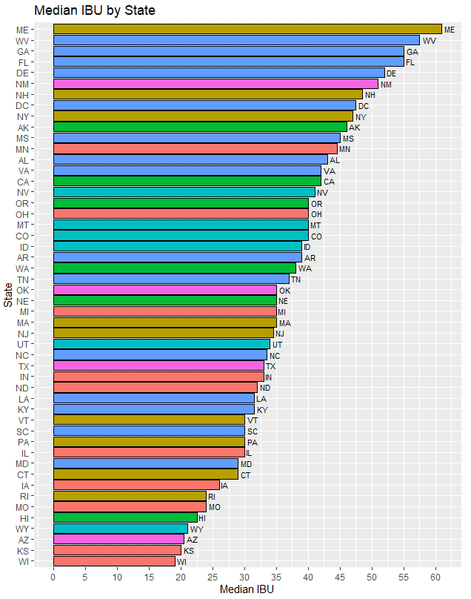
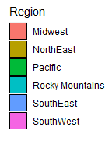
Median ABV & IBU by State
Data Inferences
Higher Median ABV and IBU seen in South East States
Higher Brewery regions (Pacific & Midwest Region) have lower median ABV & IBU

Slide 9
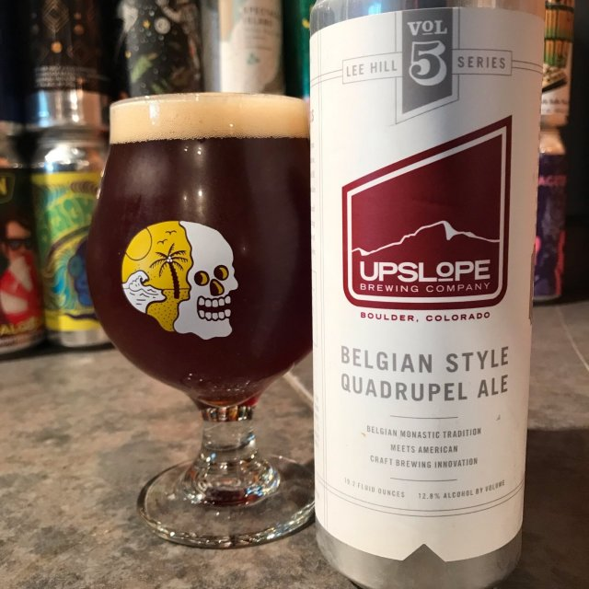
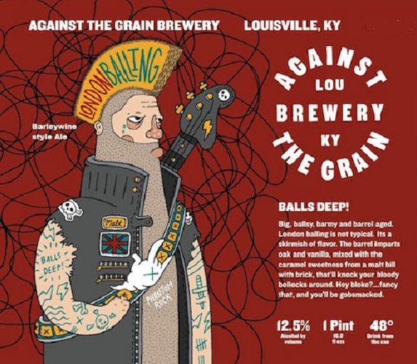
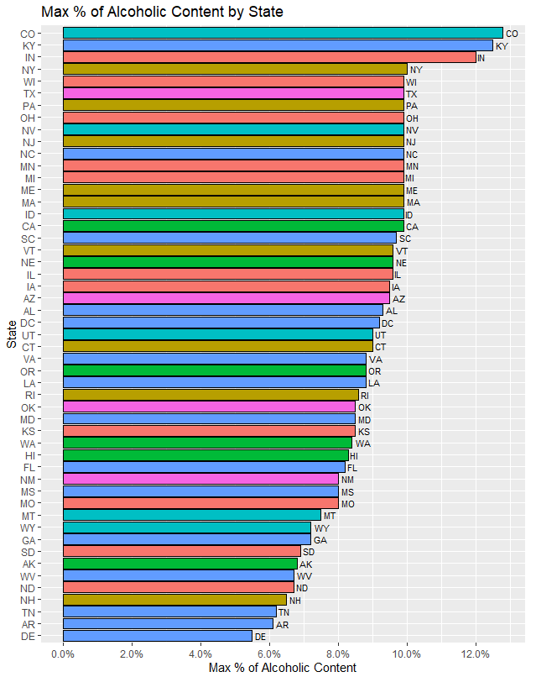
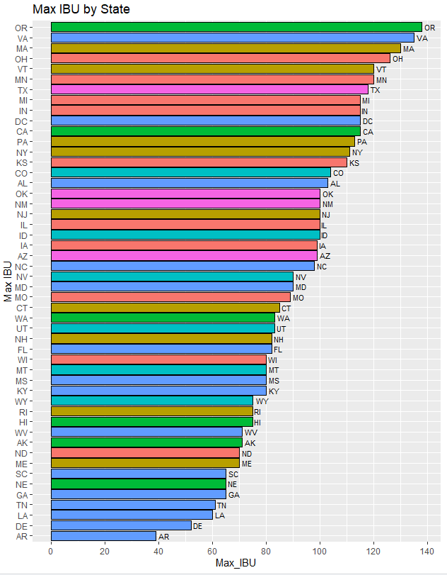
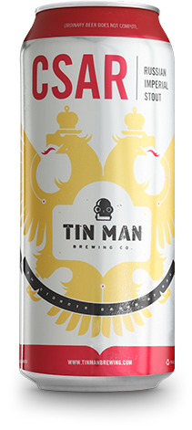
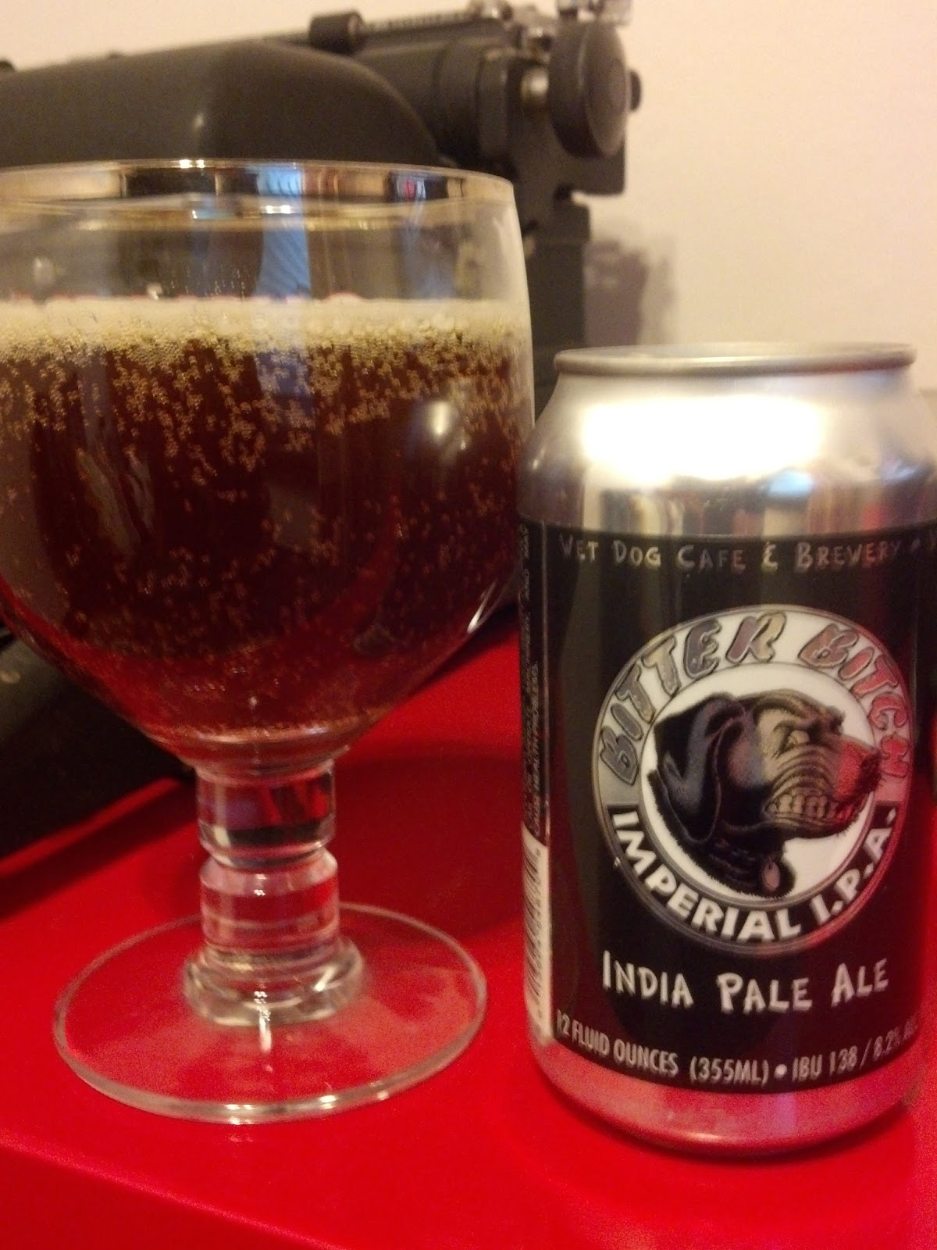
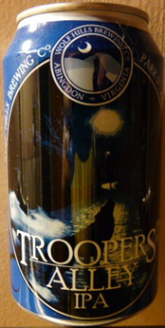
Max ABV & IBU by State
CO: Lee Hill Series Vol. 5 - Belgian Style Quadrupel Ale (12.8% ABV)
KY: London Balling (12.5% ABV)
IN: Csar Russian Imperial Stout (12.0% ABV)
OR : Bitter Bitch Imperial IPA (138 IBU)
VA : Trooper Valley IPA (135 IBU)
Data Inferences
CO, KY, IN have the beers with the highest alcohol content
OR & VA have the beers with the highest IBU

Slide 10
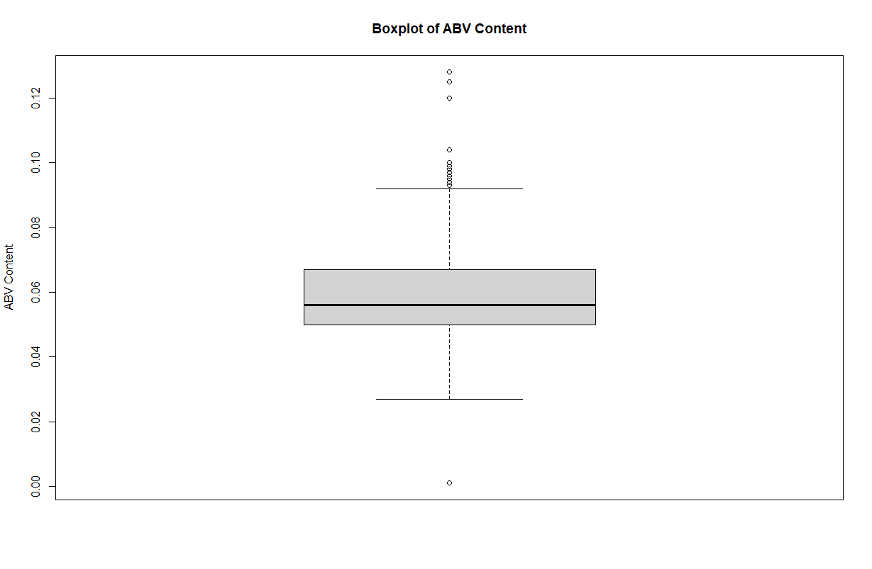
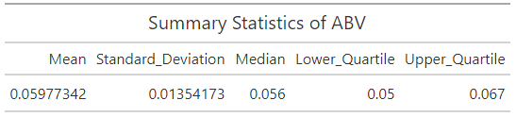
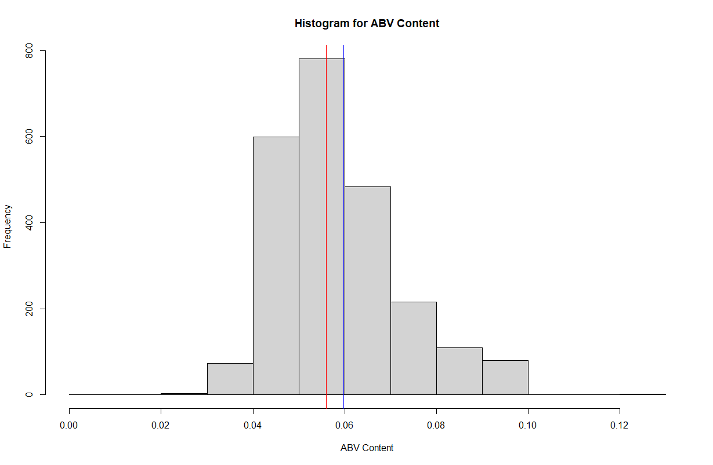
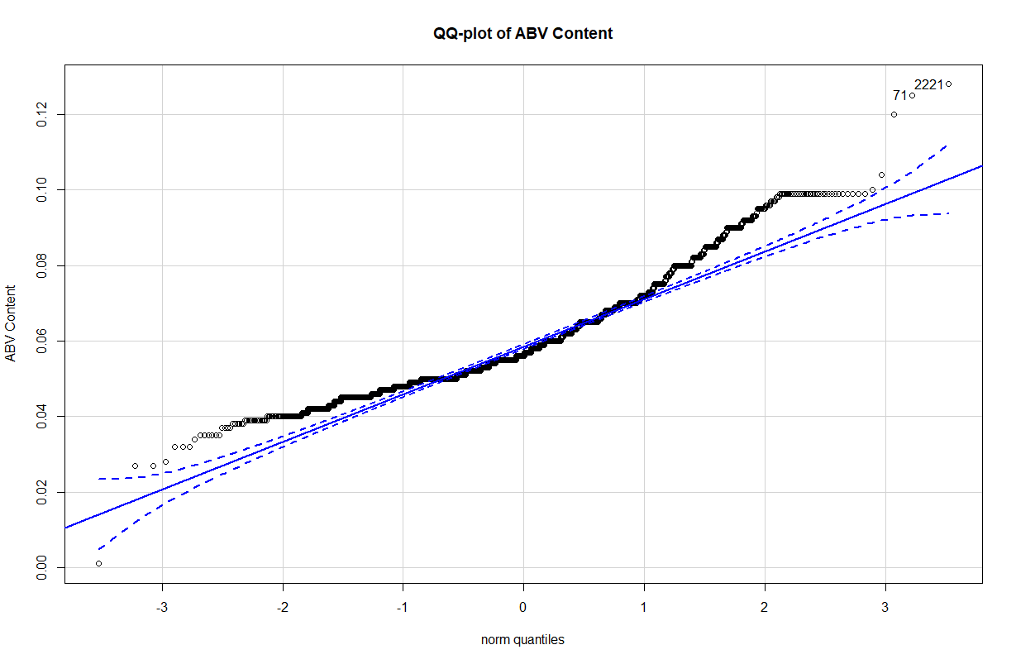
Summary Statistics & Distribution of ABV
Data Inferences
ABV data appears to be right skewed
Avg and Median ABV content are .059 & .056
Majority of beers between the .04 and .07 ABV content

Slide 11
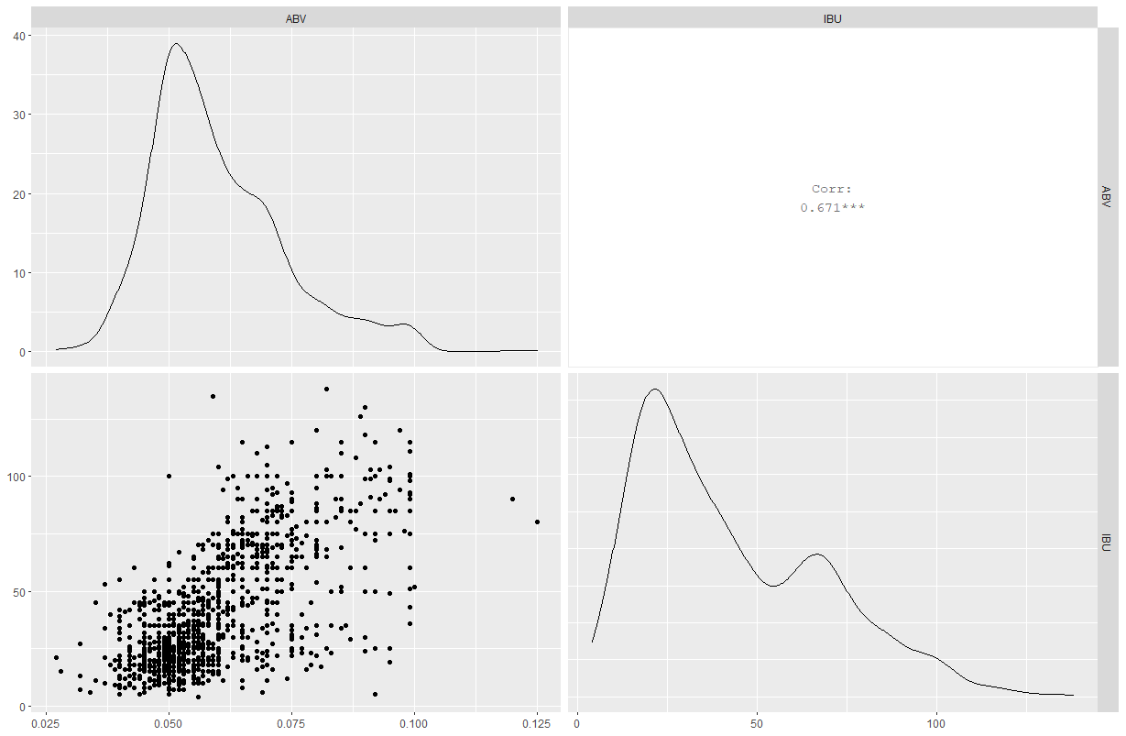
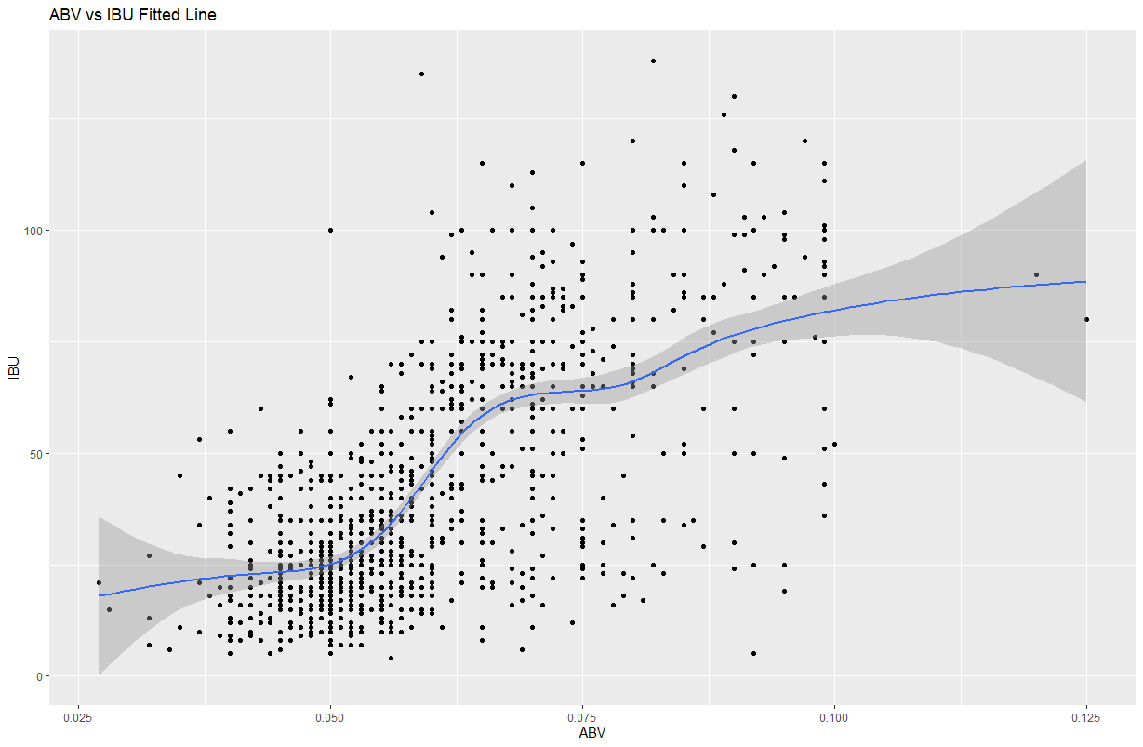
Relationship between ABV & IBU
Data Inferences
ABV and IBU have similar right skewed distributions
Strong visual evidence of Correlation between the two variables (.671)
The Correlation can be explained easily from a brewing perspective, more hops are used to create more bitter beers, to offset or balance the taste brewers add more sugar. Sugar will ferment to create a higher alcoholic content.

Slide 12
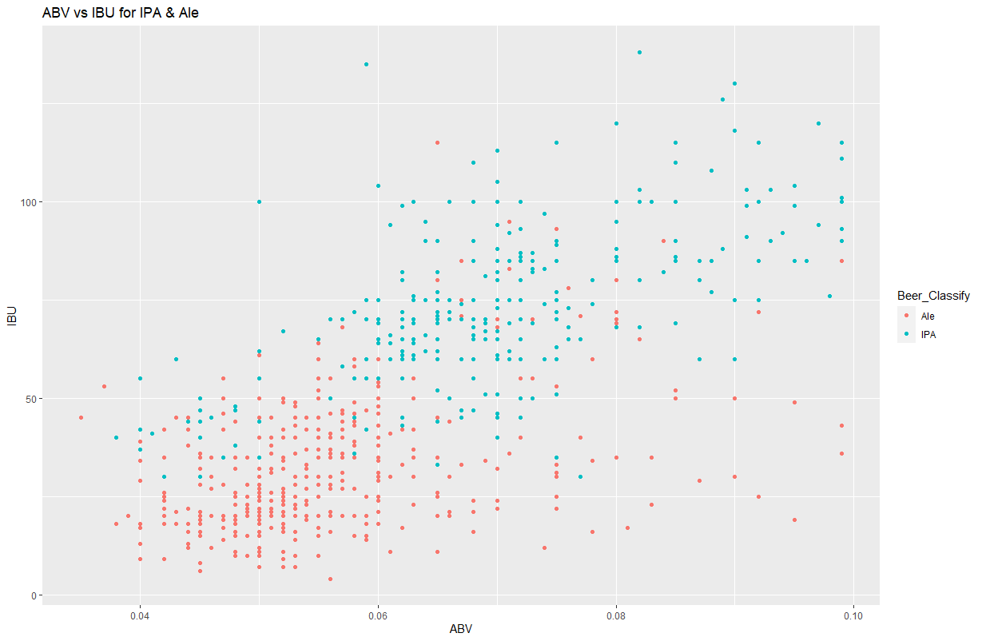
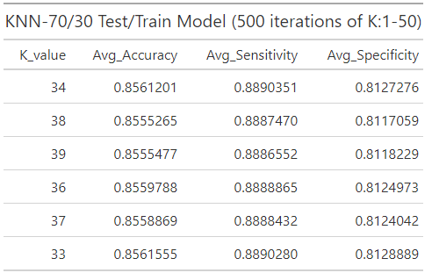
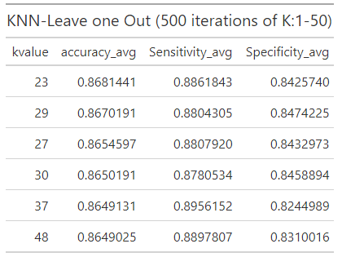
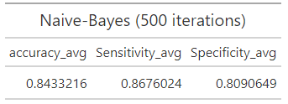
Ale vs IPA
Data Inferences
Strong evidence of clustering between IPA and Ale
Strong visual evidence of Correlation between the two variables (.671)
High Accuracy of Clustering across multiple statistical models (KNN-TT: 85%, KNN-LO:86%, NB:84.3%)

Slide 13
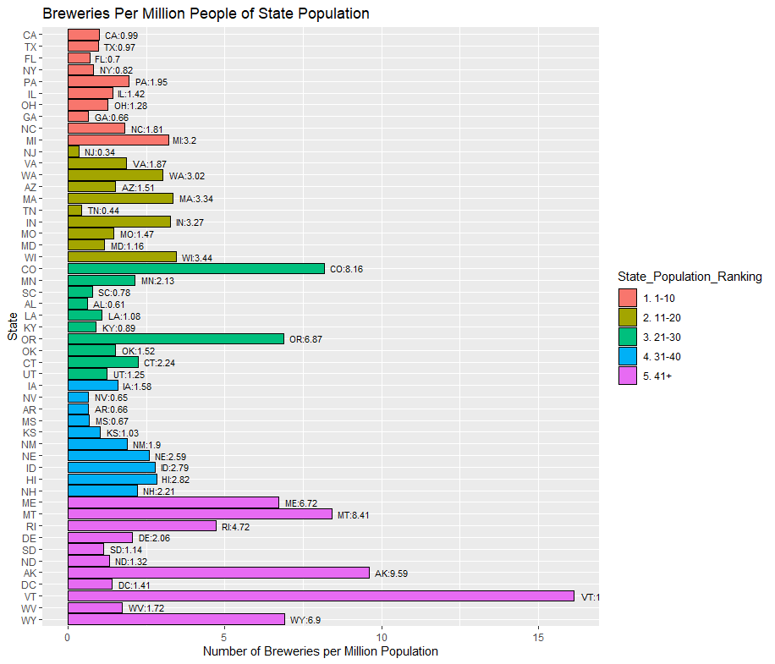
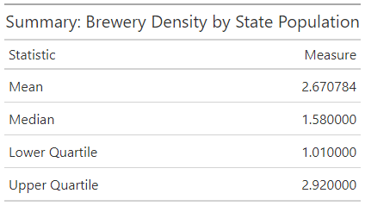
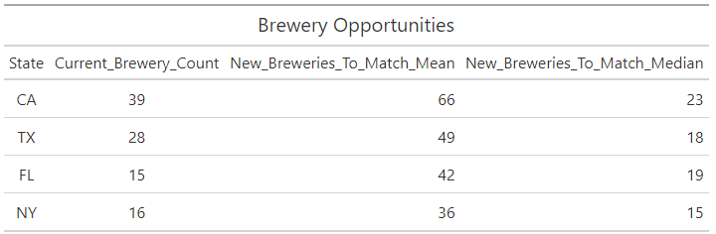
Market Expansion Opportunities: Brewery Density by State
Data Inferences
States with the highest populations have low brewery density (State Population rankings 1 & 2)
Lower population states (VT ,MT ,WY ,AK) have high brewery count relative to state population
Recommendation would be for Budweiser to expand Brewery additions in states like CA, TX, FL, NY where Brewery density is relatively low

Slide 14
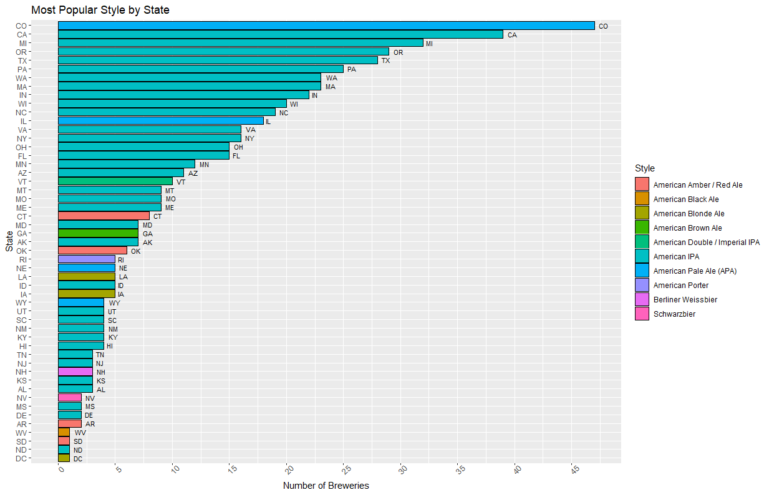
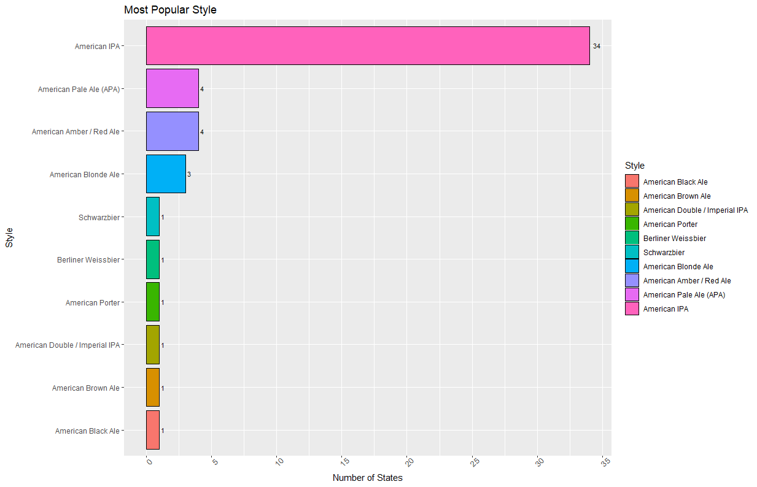
Market Expansion Opportunities: Most Popular Style
Data Inferences
IPA/Pale Ale style of beer is the most popular and across the country (76%)
Any market expansions of breweries, changes to existing selections, or development of new beers should focus on IPA/Pale Ale
Special attention should be given to states like CT, OK, GA where IPA/Pale ale is not the most popular, product offerings can be curtailed to their individual tastes.

Slide 15
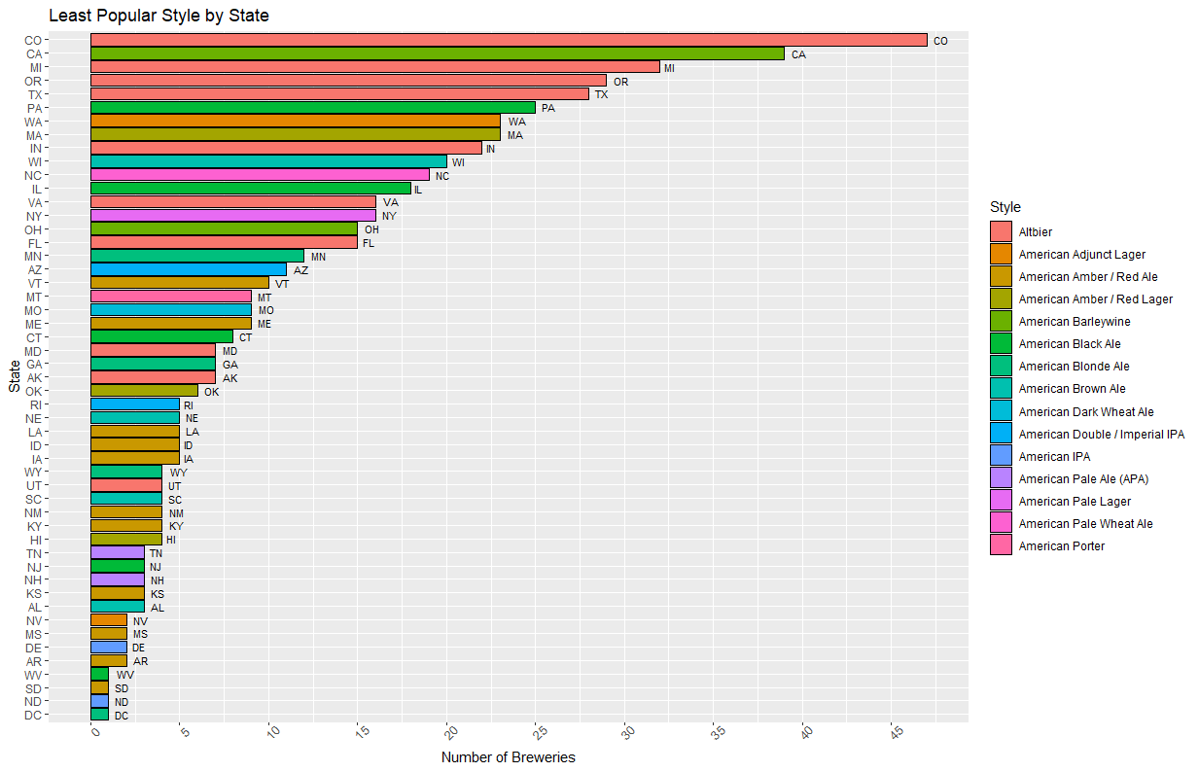
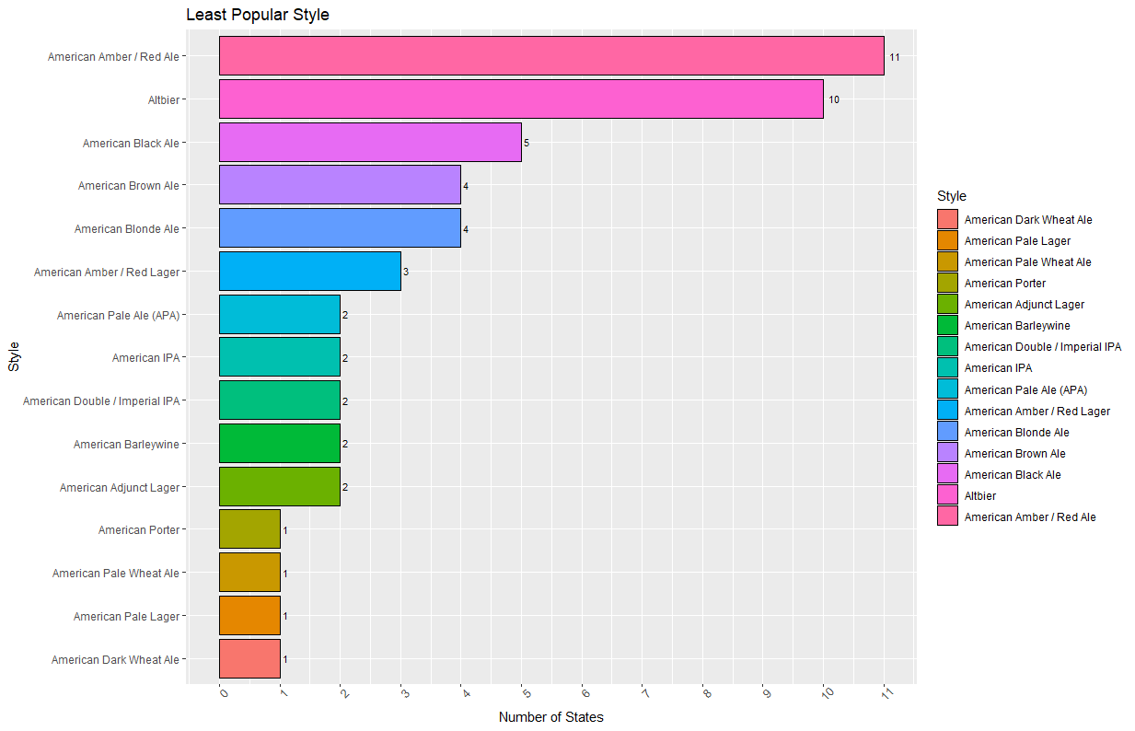
Market Expansion Opportunities: Least Popular Style
Data Inferences
American Amber/Red Ale & Altbier style of beer are least popular across the country (41%)
Should consider phasing this beer out of existing markets and not include in any brewery or beer expansions
With competition in CA from established wineries, perhaps American Barleywine should be phased out

